Slide 1
Sprint 5
PerlSquad

Slide 2
Changes since last sprint
Code clean-up and additional documentation
More instructions at start of mini-game
UI improvements
Customization improvements:
Text editing
Help screen
Largely minor improvements since last sprint

Slide 3
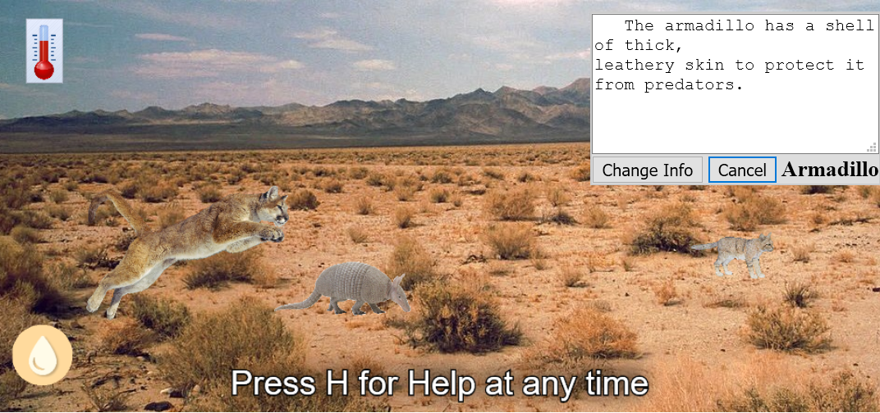
Text Editing:

Slide 4
Reflections on Agile Process
Helpful to get a clear indication of individual expectations/results from last week at each meeting
Helps identify weeks when not much progress has been made - not necessarily a negative (exams, other projects outside of this class)
Defining roadblocks helpful so that other team members can help address them

Slide 5
Wrapping up...
Further clean up code
Add additional documentation for future development
Finish up customization features
Get additional client feedback & implement it if time allows
Bug fixing

Slide 6
DEMO TIME...

